Slide 1
Ukraine in the post-war period (1945-1991). Ukraine in the conditions of independence.
by Spitsa N.V. Didyk S.S.

Slide 2
Plan
1. The results of World War II for Ukraine. Reconstruction
2. De-stalinization , Stagnation, Perestroika (Reformation) (1953-1991)
3. Independence of Ukraine in 1991.
4. Present days of Ukraine (1991-2018).

Slide 3
fifteen republics of the Soviet Union

Slide 4
World War II deaths

Slide 5
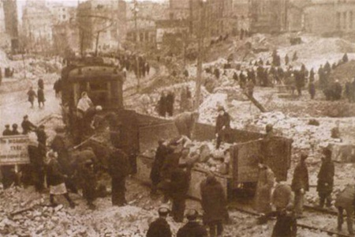
Reconstruction
In 1945 Industrial production was only 26% of 1940 level
Heavy industry received 80% of instrument the reconstruction effort was remarkably successful
In 1950s Ukraine became one of the leading industrial countries in Europe.

Slide 6
Agriculture was damaged to a greater degree than industry
1946 because of drought peasants of Ukraine experienced famine for the third time under Soviet rule

Slide 8
Khrushchev's THAW
Nikita Khrushchev
September 14, 1953 – October 14, 1964

Slide 9
Stalin's death (1953) introduced a new era in Soviet History
1956 – 20th Party Congress – program of
de-stalinization started: many people were amnestied and allowed to return homes

Slide 10
Khrushchev meeting U.S. president John F. Kennedy in 1961
Nikita Khrushchev and Dwight Eisenhower at a state dinner in 1959

Slide 11
Emergence of such popular stars as
Bulat Okudzhava,
Edita Piekha,
Evgeny Evtushenko,
Bella Akhmadulina,
and the superstar Vladimir Vysotsky had changed the popular culture forever in the USSR. Their poetry and songs liberated the public consciousness

Slide 12
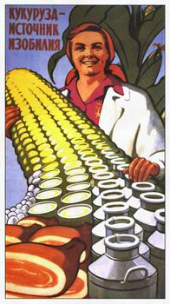
Involving 70 million acres of USSR to raising vast amounts of corn. (He followed the American example)

Slide 13
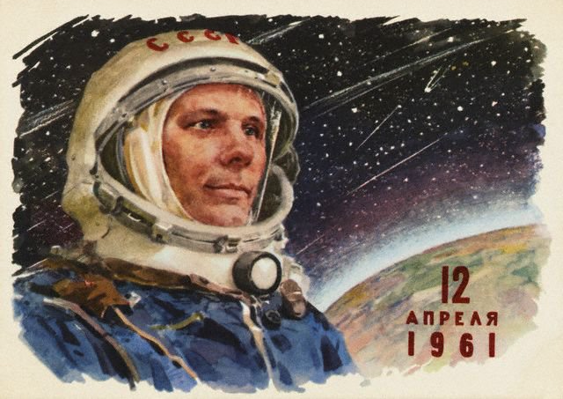
Yuri Gagarin - first human to journey into outer space
“Vostok” spacecraft completed an orbit of the Earth on
12 April 1961

Slide 14
Valentina Tereshkova
Soviet cosmonaut
The first woman in space (on 16 June 1963)

Slide 15
Era of Stagnation
Leonid Brezhnev
14 October 1964 – 10 November 1982

Slide 16
Leonid Brezhnev and his time
By the 60th extreme conservatism became a hallmark of the Soviet regime
Moscow, not Kiev continued to make all major decisions that affected Ukrainians

Slide 17
1964-1982 conservative tendencies which were clearly authoritarian
Rapid urbanization
Arising dissidents (urban intelligence)
social stagnation:
Brezhnev reverted several of the relatively liberal reforms of his predecessor, Nikita Khrushchev, and he partially rehabilitated Joseph Stalin

Slide 18
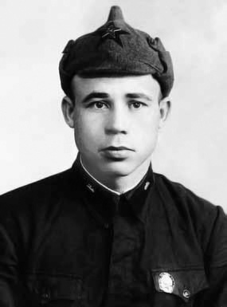
Ukraine under Shelest
Until Leonid Brezhnev achieved preeminence by the mid-1970s, power in Moscow after Khrushchev’s ouster was shared by a collective leadership headed by a triumvirate consisting of Brezhnev, Aleksey Kosygin, and Pidhorny.
Young Shelest in Red Army

Slide 19
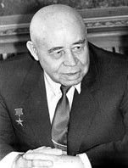
Shelest, Pidhorny’s protégé, became a full member of the Politburo within a month of Khrushchev’s ouster. However, Brezhnev’s client, Shcherbytsky, shortly reemerged from relative obscurity; he reassumed the premiership in Kiev in 1965 and became a candidate member of the Politburo in Moscow in 1966.

Slide 20
Perestroika (restructuring)
Mikhail Gorbachev
1 October 1988 – 25 December 1991

Slide 21
Deficit of consumer goods

Slide 22
Gorbachev initiated his new policy of perestroika and its attendant radical reforms in 1986

Slide 23
According to Gorbachev, perestroika was the "conference of development of democracy, socialist self-government, encouragement of initiative and creative endeavor, improved order and disciple, more glasnost, criticism and self-criticism in all spheres of our society. It is utmost respect for the individual and consideration for personal dignity.”

Slide 24
Chernobyl disaster
nuclear accident of catastrophic degree 26 April 1986
at the Chernobyl Nuclear Power Plant in Ukraine (not far from Kiev)

Slide 25
Dissolution of the Soviet Union
The Union of Soviet Socialist Republics (USSR) was formally dissolved on December 25, 1991. This left all fifteen republics of the Soviet Union as independent sovereign states. The dissolution of the world's largest communist state also marked an end to the Cold War.

Slide 26
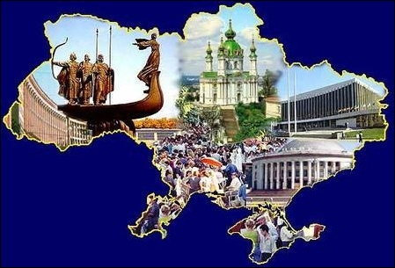
Independence

Slide 27
16 July 1990
Declaration of state sovereignty of Ukraine
December 1, 1991 Referendum (a direct vote in which an entire electorate is asked to either accept or reject a particular proposal)

Slide 28
Independence Day of Ukraine
Independence Day of Ukraine is the main state holiday in the modern Ukraine, celebrated on August 24 in commemoration of the Declaration of Independence, 1991.

Slide 29
Constitution DAY
June, 28 (1996)
Constitution DAY

Slide 30
Leonid Kravchuk
1st President of Ukraine
In office:
December 5, 1991 – July 19, 1994

Slide 31
Leonid Kuchma
2nd President of Ukraine
In office:
19 July 1994 –
23 January 2005

Slide 32
Orange Revolution
from late November 2004 to January 2005

Slide 33
The Orange Revolution (Ukrainian: Помаранчева революція, Pomarancheva revolyutsiya) was a series of protests and political events that took place in Ukraine from late November 2004 to January 2005, in the immediate aftermath of the run-off vote of the 2004 Ukrainian presidential election, which was claimed to be marred by massive corruption, voter intimidation and direct electoral fraud.

Slide 34
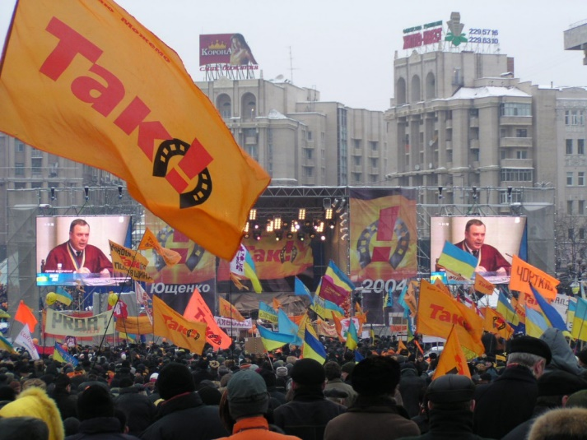
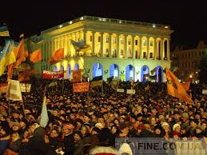
Kiev, the Ukrainian capital, was the focal point of the movement's campaign of civil resistance, with thousands of protesters demonstrating daily.^{[7]} Nationwide, the democratic revolution was highlighted by a series of acts of civil disobedience, sit-ins, and general strikes organized by the opposition movement.

Slide 35
Viktor Yushchenko
3rd President of Ukraine
In office:
23 January 2005 –
25 February 2010

Slide 36
Viktor Yanukovych
since February 25, 2010-2014

Slide 37
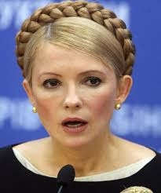
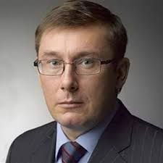
In 2011 former prime minister Tymoshenko, the country’s most popular politician, was convicted of abuse of power in connection with a 2009 natural gas deal with Russia and given a seven-year prison sentence. In February 2012 Tymoshenko’s interior minister, Yuri Lutsenko, also was convicted of abuse of power and sentenced to four years in prison. Many observers believed both trials were politically motivated.

Slide 38
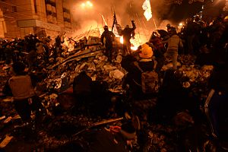
Revolution of Dignity
The Ukrainian revolution of 2014 (also known as the Euromaidan Revolution or Revolution of Dignity; Ukrainian: Революція гідності, Revoliutsiia hidnosti) took place in Ukraine in February 2014, when a series of violent events involving protesters, riot police, and unknown shooters in the capital, Kiev, culminated in the ousting of the democratically elected ^{[34]}Ukrainian President, Viktor Yanukovych.^{[35]}

Slide 39
Revolution of Dignity
The events were followed by a series of changes in Ukraine's sociopolitical system, including the formation of a new interim government, the restoration of the previous constitution, and a call to hold impromptu presidential elections within months. Fifty seven percent of people in the government-controlled east regard the change in power as an "illegal armed coup". Opposition to the revolution in some eastern and southern regions escalated into the annexation of Crimea by the Russian Federation, its later military intervention and the subsequent War in Donbass.

Slide 40
The crisis in Crimea and eastern Ukraine

Slide 41
The crisis in Crimea and eastern Ukraine
As pro-Russian protesters became increasingly assertive in Crimea, groups of armed men whose uniforms lacked any clear identifying marks surrounded the airports in Simferopol and Sevastopol. Masked gunmen occupied the Crimean parliament building and raised a Russian flag, as pro-Russian lawmakers dismissed the sitting government and installed Sergey Aksyonov, the leader of the Russian Unity Party, as Crimea’s prime minister.

Slide 42
Voice and data links between Crimea and Ukraine were severed, and Russian authorities acknowledged that they had moved troops into the region. Turchynov criticized the action as a provocation and a violation of Ukrainian sovereignty, while Russian Pres. Vladimir Putin characterized it as an effort to protect Russian citizens and military assets in Crimea. Aksyonov declared that he, and not the government in Kiev, was in command of Ukrainian police and military forces in Crimea.

Slide 43
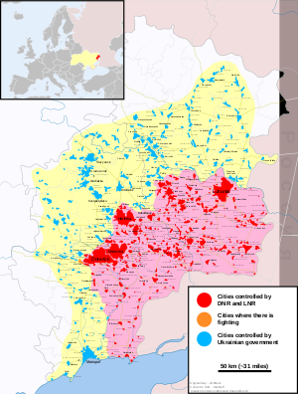
War in Donbass
The War in Donbass is an armed conflict in the Donbass region of Ukraine. From the beginning of March 2014, protests by pro-Russian and anti-government groups took place in the Donetsk and Luhansk oblasts of Ukraine, together commonly called the "Donbass", in the aftermath of the 2014 Ukrainian revolution and the Euromaidan movement.

Slide 44
War in Donbass
These demonstrations, which followed the annexation of Crimea by the Russian Federation (February to March 2014), and which were part of a wider group of concurrent pro-Russian protests across southern and eastern Ukraine, escalated into an armed conflict between the separatist forces of the self-declared Donetsk and Luhansk People's Republics (DPR and LPR respectively), and the Ukrainian government.

Slide 45
War in Donbass
In the Donetsk People's Republic, from May 2014 until a change of the top leadership in August 2014, some of the top leaders were Russian citizens. During the middle of 2014, Russian paramilitaries were reported to make up between 15% and 80% of the combatants. There were an estimated 6,000 Russian troops and 40,000 rebels inthe Donetsk and Luhansk regions of Ukraine as of September 2017.

Slide 46
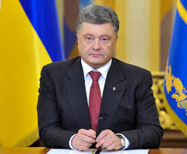
New President
Petro Poroshenko
Petro Oleksiyovych Poroshenko
is the fifth and current President of Ukraine, in office since 2014.
He served as the Minister of Foreign Affairs from 2008 to 2011, and as the Minister of Trade and Economic Development in 2012. From 2008 until 2013, Poroshenko headed the Council of Ukraine's National Bank.

Slide 47
THANK YOU FOR YOUR ATTENTION!
by Spitsa N.V. & Didyk S.S. company

