Slide 1
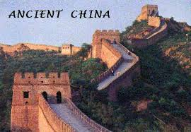
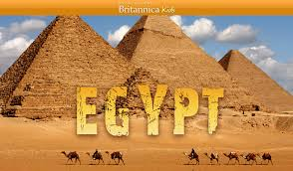
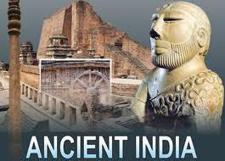
Medicine of Ancient China, India, Mesopotamia and Egypt.
Lecturer – Pushina O.S.

Slide 2
PLAN
Civilization of Mesopotamia.
Mesopotamian concepts of disease and healing.
Healthcare in ancient Mesopotamia.
History of Ancient Egypt.
Inventions of Ancient Egyptians.
Healthcare in ancient Egypt.
History of Ancient China
Inventions of Ancient Chinese.
Healthcare in ancient China.
History of Ancient India.
Inventions of Ancient Indians.
Healthcare in Ancient India.

Slide 3
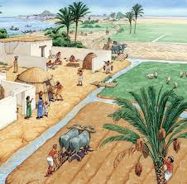
Mesopotamia - the name means “the land between the rivers”. Refers to the geographic region which lies near the Tigris and Euphrates Rivers. Many civilizations developed, collapsed, and were replaced.

Slide 4
Cradle of civilizations
The region is made fertile by the flooding of the Tigris and Euphrates Rivers. The floods aided agriculture by adding rich silt to the soil. Tremendous amount of human labor was needed to irrigate the land and to protect the young plants from the flood.

Slide 5
Given the combination of fertile soil and the need for organized human labor, it is not surprising that the first civilization developed in Mesopotamia.

Slide 6
Features of Mesopotamian civilizations Agriculture.
Towns grew to be cities.
Cuneiform writing was used.
Metal working had begun.
Temples were built on a monumental scale.
The Ur Ziggurat. In it's day, it was taller. There was a temple built atop of this structure.

Slide 7
Cuneiform writing
A system of writing established by the Sumerians (c.3100 BC), which required the use of a stylus in order to make wedge-shaped marks on wet clay tablets.
Once the tablets were dry they could be stored, transported, etc.
Became the dominant system of writing in Mesopotamia for over 2000 years.
Notes:
Once the tablets were dry they could be stored, transported, etc. Became the dominant system of writing in Mesopotamia for over 2000 years. Even after Sumerian became extinct as a spoken language, many other cultures continued to write using cuneiform. As a result of its extensive use of several centuries, many cuneiform tablets have survived

Slide 8
Mesopotamian concepts of disease and healing
Spirits were blamed.
Each spirit or god was held responsible for only one disease.
Specific offerings were made to a particular god or ghost when it was considered to be a causative factor.
Notes:
Specific offerings were made to a particular god or ghost when it was considered to be a causative factor, but these offerings are not indicated in the medical texts. It was recognized that various organs could malfunction, causing illness. The plants used in treatment were to treat the symptoms of the disease, and were not given for magical purposes. Sumerian gods

Slide 9
Mesopotamian concepts of disease and healing
Assyrian palace gateways were flanked by protective winged bulls to drive away illness carrying demons.

Slide 10
Mesopotamian medical practitioners
Two distinct types of professional medical practitioners: Ashipu and Asu. Ashipu also accounted as exorcist.
Notes:
Ashipu also accounted as exorcist. Diagnose the ailment, this meant which god or demon was causing the illness. Determine if the disease was the result of some error or sin of the patient. Attempt to cure the patient by means of charms and spells that were designed to drive out the spirit causing the disease.

Slide 11
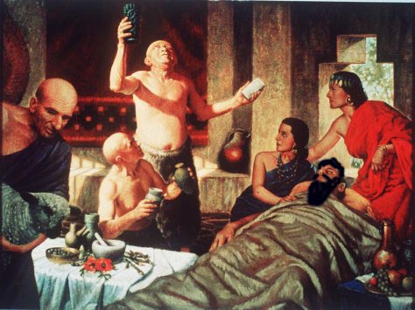

Slide 12
Mesopotamian medical practitioners
Asu also accounted as “physician“. Specialist in herbal remedies.
Dealt with empirical applications of medication (washing, bandaging and making plasters).
Notes:
For example, when treating wounds the asu generally relied on washing, bandaging, and making plasters (a mixture of medicinal ingredients applied to a wound and held on by a bandage). Seal of a Babylonian Asu with reverence to the gods, a self-portrait and depictions of bronze knives, cups and needles..

Slide 13
Other health providers
Temple of Gula (a goddess of healing): Patients were not housed at the temples dedicated to Gula while they were treated. The majority of health care was provided at the patient's own house by the family.
The goddess Gula with her dog. Detail from a boundary stone dated to the reign of Babylonian king Nabu-mukin-apli, 978-943 BCE.

Slide 14
Other health providers

Slide 15
Sources of Mesopotamian medicine
Most of the information comes from cuneiform tablets. Medical texts (420 tablets) were found at the library of a medical practitioner from Ashur. Prescription tablets.
Sumerian medical tablet (2400 BC), ancient city of Nippur. Lists 15 prescriptions used by a pharmacist.

Slide 16
The library of Ashurbanipal
The library of Ashurbanipal Last great king of Assyria. Tablets were housed in the king's palace at Nineveh. When the palace was burned by invaders, around 20,000 clay tablets were baked (and thereby preserved). 660 medical tablets from the library of Ashurbanipal were published.
Notes:
Ashurbanipal 669-627 B.C. - ruled and expanded Assyria to include Babylonia, Persia, Egypt, and Syria. Ashurbanipal describes himself as a literate person in an account written by himself on his life and education.

Slide 17
“Treatise of Medical Diagnosis and Prognoses“
Treatise of Medical Diagnosis and Prognoses“ 40 tablets related to each other. Dates to around 1600 BC. Organized in head to toe order with separate subsections covering convulsive disorders, gynecology and pediatrics.
Notes:
The descriptions of diseases demonstrate a keen ability to observe and are usually clever. All expected diseases can be found described when those parts of the tablets are fully preserved, as they are for neurology, fevers, worms and skin lesions. The medical texts are rational. Some of the treatments are essentially the same as modern treatments for the same condition.

Slide 18
Law Code of Hammurabi
A collection of legal decisions made by Babylonian king Hammurabi (c. 1700 BCE). Of the 282 edicts, 15 mentioned physicians, veterinarians, barbers or midwives. A doctor was to be held responsible for surgical errors and failures.

Slide 19
Law Code of Hammurabi
Notes:
The descriptions of diseases demonstrate a keen ability to observe and are usually clever. All expected diseases can be found described when those parts of the tablets are fully preserved, as they are for neurology, fevers, worms and skin lesions. The medical texts are rational. Some of the treatments are essentially the same as modern treatments for the same condition.

Slide 20
Law Code of Hammurabi
If a person of high status died as a result of surgery, the surgeon risked having his hand cut off. If a slave died from receiving surgical treatment, the surgeon only had to pay to replace the slave.
Notes:
. The severe punishment for negligence supposedly weeded out physicians incapable of delivering adequate care A physician testifies and defends himself in a trial concerning a malpractice complaint by his patient Hammurabi strictly enforced compliance through severe penalties. If they were not satisfied, patients could seek justice from a legal system

Slide 21
Spiritual methods of treatment Charm
1. Healers often prescribed protective necklaces to be worn during times of illness or stress.
2. Spells.
3. Rituals.
4. Sacrifices.
Notes:
Assyrian jewellery was not simply pretty adornment. Coloured stones (and glass) were considered to have beneficial properties: they warded off evil and protected against harm.

Slide 22
Empirical methods of treatment
Surgery.
Treating fractures.
Pharmaceuticals.
Delivery.
Empathy and encouragement.
Medical instruments from Mesopotamia

Slide 23
Surgery
Cesarean section performed on a dead woman.
A procedure in which the asu cuts into the chest of the patient in order to drain pus from the pleura.
Postoperative care of a surgical wound - application sesame oil (anti-bacterial agent).

Slide 24
Pharmaceuticals
More than 250 medicinal plants (extracts, resins, or spices).
120 mineral substances and 180 other drugs were combined with alcoholic beverages, fats, honey, milk in various forms, oils, wax and parts and products of animals.
Notes:
Many of the drugs mentioned in the tablets are difficult to identify: often the asu used metaphorical names for common drugs. Many of the plants incorporated into the asu prescriptions had antibiotic properties, while several resins and many spices have some antiseptic value, and would mask the smell of a malodorous wound Medications were ground and filtered for ointments or plasters to spread on a piece of thin leather to apply. Prescriptions specified enemas, laxatives, ointments, pills, powders, and suppositories. There was no extra charge for medications.

Slide 25
Medicine of Ancient Egypt

Slide 26
ANCIENT EGYPTIAN SOCIETY
Throughout these 3,000 years ancient Egyptians lived under about 30 dynasties, with each dynasty being based on the lineage of the kings/pharaohs.
The land began as two (Upper & Lower Egypt), with King Menes uniting the two regions at around 3,500 B.C.E.
Notes:
In art and on tombs,
the pharaohs were now depicted with the crowns of Upper and Lower Egypt combined to become one crown, known as the pschent

Slide 27
The reason for the difference in names refers to the flow of the life-giving Nile River. Egypt was divided into two types of land, the 'black land' and the 'red land'.
The 'black land' was the fertile land on the banks of the Nile. The ancient Egyptians used this land for growing their crops.
Notes:
This was the only land in ancient Egypt that could be farmed because a layer of rich, black silt was deposited there every year after the Nile flooded.

Slide 28
The 'red land' was the barren desert that protected Egypt on two sides. These deserts separated ancient Egypt from neighbouring countries and invading armies. They also provided the ancient Egyptians with a source for precious metals and semi-precious stones.

Slide 29
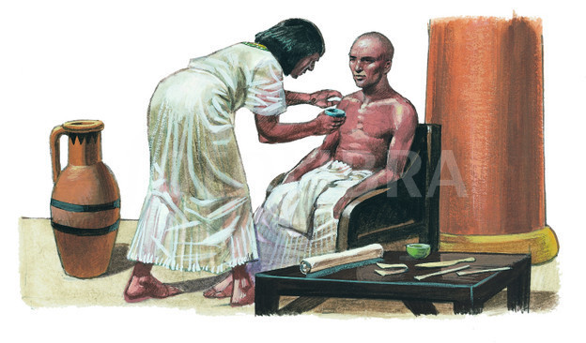
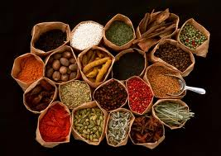
Successful agriculture provided spare food so more people were doctors, priests and other professionals.
More trade and communications – new herbs and plants were imported.
The Egyptians had writing – ideas could be recorded and communicated better than previously.

Slide 30
INVENTIONS OF ANCIENT EGYPT
Calendar
The Egyptians created 365 days calendar.
The Nile river flooded at the same time each year.
The Egyptians counted the days between flooding and created calendar.

Slide 31
The Pyramids of Egypt
The Pyramids of Egypt at Gyza are the best preserved of Seven Wonders of the Ancient World.

Slide 32
Medicine in ancient Egypt was but one aspect of an advanced civilization. It was not practiced by witch doctors as in primitive tribes, with mixture of magic, herbal remedy, and superstitious beliefs. This was acknowledged by Homer in the Odyssey “ In Egypt, the men are more skilled in Medicine than any of human kind ”.

Slide 33
HIGH DEGREE OF SPECIALIZATION.
“The practice of medicine is very specialized among them. Each physician treats just one disease. The country is full of physicians, some treat the eye, some the teeth, some of what belongs to the abdomen, and others internal diseases.” Herodotus, Histories 2,84

Slide 34
PAPYRUS and HIEROGLIPHCS
The Ancient Egyptians made paper out of papyrus. They cut the reeds and pressed them flat with large rocks. Scribes used the paper to keep records such as laws and taxes.

Slide 35
HIEROGLIPHCS
Hierogliphcs are pictures that stand for sounds.
There were over 750 pictures used.
It is one of the first written languages.

Slide 36
Mummies.
Ancient Egyptians had very strong worship of animals, especially of snakes and strong faith into eternal life after death.
That is why they tried to save bodies from destroying by embalming them. The art of embalming was developed on a very high level. Now this secret is lost

Slide 37
Gods of medicine of Egypt
Sekhmet was associated both with disease and with healing and medicine. She was usually depicted as a lioness or as a woman with the head of a lioness, on which was placed the solar disk and the uraeus serpent.
The world’s first physician known by name was the Egyptian Imhotep, who lived about 2650 B.C. The Egyptians later worshiped him as the God of healing.

Slide 38
Thoth
Thoth was the god thought to be the god who gave the physicians in Egypt the power to heal and cure. Such was the influence of religion that the early medical texts were called the Books of Thoth.

Slide 39
NATURAL BELIEFS AND TREATMENT

Slide 40
The Channel Theory
The river Nile led to suggest that, like the Nile and irrigation systems, the body was full of channels.
They thought the heart was the center of 46 channels - types of tubes.
They thought that you became ill if the channels of your body were blocked.
They used purging, vomiting and blood-letting to unblock the channels when someone became unwell.
Notes:
To a certain extent, they were right, our veins, arteries, and even our intestines are types of tubes. However, they never came to realize that these channels had different functions.
The channel theory allowed medicine to move from entirely spiritual cures for diseases and disorders, towards practical ones. Many medical historians say this change was a major turning point, a breakthrough in the history of medicine.

Slide 41
The Egyptians also knew diet was important - medical procedures included recommended foods.
Keeping clean – the Egyptians washed every day. The priests washed three times a day and shaved their whole bodies.

Slide 42
DELIVERY AND CONTRACEPTION
Delivery was performed in the squatting position, with the woman supporting her arms on knees and sitting on two bricks.
Difficult labors were aided by massaging the abdomen by saffron powder and beer.
Abortions - introduction of warm oil and fat in the vagina.
Contraception was also performed by the insertion of crocodile oil, gum acacia into the vagina.

Slide 43
BREAST FEEDING
Infants were breast fed for three years, and this was encouraged: “ Nothing is more lawful than one’s mother milk ”.
Only when the mother failed to feed her infant, they resorted to cow milk.

Slide 44
FERTILITY DIAGNOSIS
Fertility was diagnosed by placing garlic in the vagina for one night. If the next day the woman can taste or smell it in her mouth, she is fertile. This is based upon the connection between the genital parts and interior of the body. Such connection would be lost in a case of obstructed Fallopian tubes.
Notes:
In modern medicine, phenolphthalein injected in the uterus would appear in urine based upon the same principle. A test known to gynecologists as “Speck’s test

Slide 45
THE MEDICAL PAPYRI
A few papyri have survived, from which we can learn about Egyptian medicine.
The Edwin Smith Papyrus describing surgical diagnosis and treatments.
The Ebers Papyrus on ophthalmology, diseases of the digestive system, the head, the skin and specific , contains a large number of prescriptions and recipes.
The Kahun Gynaecological Papyrus.
The Brugsha Medical Papyrus .

Slide 46
MEDICAL PAPYRI
The oldest yet discovered papyrus is the “ Kahun Gynecology Papyrus”, dating back to 1825 BC , during the reign of Amnemhat III. It describes methods of diagnosing pregnancy and the sex of the fetus, toothache during pregnancy, diseases of women, as well as feminine drugs, pastes and vaginal applications.

Slide 47
The Edwin Smith Papyrus
The Edwin Smith Papyrus is 5 meters long, and is chiefly concerned with surgery. It described 48 surgical cases of wounds of the head, neck, shoulders, breast and chest. It included a vast experience in fractures that can only be acquired at a site where accidents were extremely numerous, as during the building of the pyramids.

Slide 48
The Ebers Papyrus
The Ebers Papyrus is a huge roll of more than 20 meters long and 30 cm wide. It is chiefly an internal medicine reference, as well as diseases of the eye, skin, extremities, gynecology and some surgical diseases. Anatomical and physiological terminology are also included. For treatment of those diseases, 877 recipes and 400 drugs were described.

Slide 49
DIETARY DEFICIENCIES
Because of vitamin and other deficiencies dental abrasion, and bad mouth hygiene, caries and abscesses were the lot of many ancient Egyptians

Slide 50
HERBAL MEDICINE
Herbs played a major part in Egyptian medicine. The plant medicines mentioned in the Ebers papyrus for instance include opium, cannabis, myrrh, frankincense, fennel, cassia, senna , thyme, henna, juniper, aloe, linseed and castor oil.
Notes:
Egyptians thought garlic and onions aided endurance, and consumed large quantities of them. Raw garlic was routinely given to asthmatics and to those suffering with bronchial-pulmonary complaints. Onions helped against problems of the digestive system. (e.g. pEbers 192 )

Slide 51
SURGERY
Performance of surgery is seen on the walls of many temples. at saqqara there is the tomb of ankh-mahor, known as the tomb of the physician . Wall reliefs show amputees and treatment to the stumps trephanation was practised too

Slide 52
SURGERY
The Edwin Smith Papyrus shows the suturing of non-infected wounds with a needle and thread.
Raw meat was applied on the first day, subsequently replaced by dressing of astringent herbs, honey and butter or bread. Raw meat is efficient way to prevent bleeding.
Honey is a potent hygroscopic material (absorbs water) and stimulates the secretion of white blood cells, the natural first body defense mechanism.
The application of sour or moldy bread was practiced in European medicine until the Renaissance.

Slide 53
CANCER
At least 39 mummies with cancer have been identified. Cancer of the uterus has been described in the Ebers papyrus. “ Another for one in whom there is eating on her uterus in whose vagina ulcers have appeared ”.

Slide 54
SURGICAL INSTRUMENTS
Cairo museum has a collection of surgical instruments, including scalpels, scissors, copper needles, forceps, spoons, lancets, hooks, probes and pincers.

Slide 55
Medicine of Ancient China

Slide 56
The Ancient Chinese invented :
paper,
gunpowder,
matches
compass.
They created incredible art, wrote marvelous literature and held splendid festivals.

Slide 57
Paper money, Umbrellas, Wheelbarrows,
Brandy and whiskey, Chess,
Kites and India Ink, are also masterpieces of Chinese.

Slide 58
NATURAL BARRIERS
For thousand of years Ancient Chinese thought they were alone on the planet, except to the barbarians to the North, the Mongols. China’s natural barriers to the west, south and east helped to protect these early people from invasions.

Slide 59
GREAT WALL OF CHINA
Started as many small pieces of wall
The barrier stretches 5,500 miles, which includes some natural barriers
Many of the walls are not connected

Slide 60
Civilization in Ancient China began along Yellow river near 5000 years ago.
These people harvested silk and used it to weave fine fabrics.
They used a potter’s wheel to make beautiful pottery.
They baked strong bricks and used them to build their homes.
They worked together on flood-control and irrigation projects.

Slide 61
Medical texts
The Yellow Emperor's Inner Canon
The Canon of Problems
The Canon of Acupuncture and Moxibustion
The Canon of the Pulse

Slide 62
Chinese medicine
Traditional Chinese medicine is 2,000 years old.
It focuses on the interconnectedness of mind, body and spirit

Slide 63
At the heart is the belief that two opposing principles,
yin and yang
must remain in balance within a person's body, and that an imbalance promotes disease.

Slide 64
Five Elements
In traditional Chinese medicine, five elements-wood, fire, earth, metal and water-relate to the
organs and tissues
of the human
body.

Slide 65
Acupuncture
Acupuncture is the stimulation of certain parts of the exterior body, called acupoints.
Each of the over 300 identified acupoints corresponds to a particular health problem.

Slide 66
Moxibustion Cautery
There are different methods of moxibustion.
Direct moxibustion is when a cone or cigar-like piece of compacted mugwort is lit and then pressed into a pressure point, burning all the way to the skin where it may blister or burn the skin.

Slide 67
Moxibustion Cautery
Yet another form of moxibustion involves the use of an acupuncture needle. The moxi-coated needle is inserted into the pressure point and the moxi is lit and burns, causing a warm sensation to radiate down the needle, warming the pressure point.

Slide 68
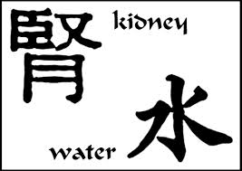
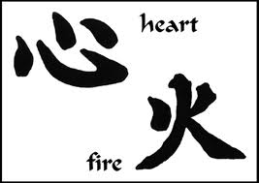
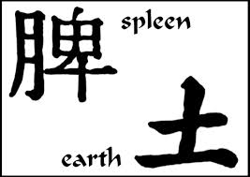
Anatomy and Physiology
Confucius forbade violation of the body - until the eighteenth century, no anatomy/direct anatomical studies.
Physiological functions were constructed into a humoral system much like Greek concepts .
The medical compendium Nei Ching – each emotion had its seat in a particular organ. Happiness dwelt in the heart, thought in the spleen, sorrow in the lungs, and the liver housed anger as well as the soul.

Slide 69
Diagnosis
The Chinese methods of diagnosis included :
questioning,
feeling the pulse,
observing the voice and body,
and in some circumstances touching the affected parts.

Slide 70
Diagnosis
EXAMINATION OF THE PULSE:
The physician felt the right wrist and then the left.
He compared the beats with his own.
Physician determined the symptoms, diagnosis, prognosis, and proper treatment by intensive palpation of the pulse.
It was considered bad for a man to intimately examine a woman, so special ceramic, ivory, and wooden dolls were pointed to indicate where discomfort was felt.

Slide 71
Medications
The Chinese pharmacopoeia was always rich.
Drugs were considered more likely to be good if they tasted bad.
Five categories: herbs, trees, insects, stones, and grains. The therapeutic minerals and metals included compounds of mercury arsenic, and magnetic stones.
Animal-derived remediesincluded virtually anything obtainable from living creatures: whole parts, segments of organs, urine, dung.

Slide 72
Herbs
EPHEDRA - was used for thousands of years as a stimulant, as a remedy for respiratory -diseases, to induce fevers and perspiration, and to depress coughs.
GINSENG ("man-shaped root"). - delaying old age, restoring sexual powers, improving diabetes and stabilizing blood pressure.

Slide 73
Qigong
Qigong is an ancient series of movement postures practi ced to create the flow of good qi, or vital energy.
Medical qigong may be internal or external.
Internal qigong relies on movement, breathing and visualization, and is practiced by the patient himself.
In external qigong, similar to therapeutic touch, a qigong master heals an ill person through qi transfer.

Slide 74
MEDICINE OF ANCIENT INDIA

Slide 75
MEDICINE OF ANCIENT INDIA
The earliest culture in India centered on Mohenjo-Daro and Harappa, chief cities of the Indus valley civilization, which flourished from about 2500 to 1500 B.C.
Advanced system of public sanitation.
Numerous wells, bathrooms, public baths, sewers, and chutes for collecting trash.
Streets were laid out in regular fashion, and houses were well built and ventilated.

Slide 76
Around 1500 B.C.

Slide 77
The Indus civilization relied on agriculture.
The majority of the people lived in villages.
Farmers cultivated wheat, barley, vegetables and fruits.
People had variety of beliefs.
Mother Goddess was believed to exist and as universal mother she bestowed fertility on plants, animals and men.

Slide 78
Hinduism is one of the oldest living religions - 4000 years old.
Veda -the oldest scripture of Hinduism.
The foundations of traditional Indian healing is called Ayurvedic medicine.

Slide 79
Medical texts
Ayurveda -"The Science of Life.“
(: ayur, - life, and veda, -knowledge.)
Its origin is traced back to the Vedic times about 5000 BC.
Ayurveda is a part of the Atharva Veda which solely deals with medicine.
Atharva Veda includes eight divisions of Ayurveda:
1. Kayachikitsa (Internal Medicine)
2. Salakya Tantra (Surgery of Head & neck, Ophthalmology and Otolaryngology)
3. Shalya Tantra (Surgery)
4. Agada Tantra (Toxicology)
5. Bhuta Vidya (Psychiatry)
6. Kaumarabhrity (Pediatric)
7. Rasayana (Anti-aging or Gerontology or Science of Rejuvenation)
8. Vajkarana (The Science of Fertility)

Slide 80
Charaka Samhita
Anatomy and Physiology.
Symptoms, signs, diagnosis and treatment of diseases of the heart, chest, abdomen, genital organs and extremities.
2 cases of disease:
1. Internal.
2. External.

Slide 81
Sushruta Samhita
1surgeon to perform rhinoplasty
Wrote a medical compendium called 'Shushruta-Samahita.
7 branches of surgery: Excision, Scarification, Puncturing, Exploration, Extraction, Evacuation, and Suturing.
The compendium also deals with matters like rhinoplasty and ophthalmology (ejection of cataracts).
The compendium also focuses on the study of the human anatomy by using dead bodies.
The early Indians also set fractures, performed amputations, excised tumors, repaired hernia and did couching for cataract.

Slide 82
Sushruta Samhita
121 different steel instruments to drain fluids, to remove kidney stones, to sew up wounds and to perform plastic surgery.
The dead bodies in cases of homicide, suicide or those who died of accidents, were kept in an examination room, which was set apart for the purpose and the cause of death, which had to be reported after post-mortem examination to higher authorities.
To prevent decomposition dead bodies were preserved by immersion in oil.

Slide 83
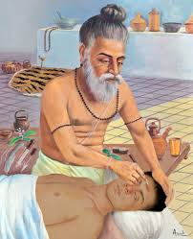
Cataract was treated by couching.
Amputations were a regular part of surgical practice, and a large and varied number of instruments (over a hundred) were available to the surgeon.

Slide 84
Diagnosis
Magical and rational approaches.
Omens played an important role.
The flight of birds, the sounds of nature, and many other observations were interpreted by the Indian physician as clues to the severity of the illness.
The patient was given intensive scrutiny, especially his sputum, urine, stool, and vomitus.

Slide 85
Medicines
Charaka listed 500 remedies and Sushruta over 700 vegetable medicines. The plant now called Rauwolfia serpentina was considered to be especially potent against headache, anxiety, and snakebite.

Slide 86
The physicians of India had a widespread reputation for being expert in treating poisonous snakebite.
Certainly the prevalence of dangerous snakes, especially cobras, must have given the doctors considerable experience.
Their procedures are illustrative of the therapeutic methods of Ayurvedic medicine.

Slide 87
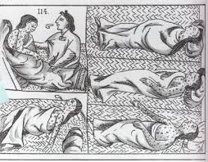
Public Health and Hygiene
There is evidence for malaria, dysenteries, cholera, smallpox, typhoid fever, plague, leprosy, tuberculosis,
Smallpox was countered by inoculating people with pus from a smallpox skin boil by puncture or scarification to prevent the full-blown illness.

