Slide 1
THE BIOETHICAL BASIS OF THE DOCTOR’S ACTIVITY. BIOETHICS OF BIOTECHNOLOGIES.
Lecturer – Pushina O.S.

Slide 2
Professional ethics - the ethical norms, values, and principles that guide a profession and the ethics of decisions made within the profession

Slide 3
One of the earliest examples of professional ethics is probably the Hippocratic oath to which medical doctors still adhere to this day.

Slide 4
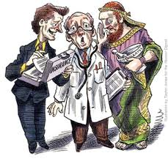
The professional
additional moral responsibilities
capable of making and acting on an informed decision
received the relevant training.
Notes:
The professional carries additional moral responsibilities than those held by the population in general.
The professionals are capable of making and acting on an informed decision in situations that the general citizens cannot, because they have not received the relevant training

Slide 5
Disciplinary codes
Disciplinary codes allow the profession to draw a standard of conduct.
Notes:
Disciplinary codes allow the profession to draw a standard of conduct and ensure that individual practitioners meet this standard, by disciplining them from the professional body if they do not practice accordingly.

Slide 6
Professional responsibility encompasses:
the duties of doctors to act in a professional manner,
obey the law,
avoid conflicts of interest,
put the interests of patients ahead of their own interests.
Notes:
Professional responsibility is the area of legal practice that encompasses the duties of doctors to act in a professional manner, obey the law, avoid conflicts of interest, and put the interests of patients ahead of their own interests.

Slide 7
Professional responsibility violations in general include:
1 – Unreasonable refuse of the delivery of health care to the patient
2 - Disclosure of confidential information
3- Low level of the quality of health care
4- Violation of the conditions of treatment
5- Causing of harm to the patient
6- Conflict of interests

Slide 8
Referral
Fee splitting and the payments of commissions to attract referrals of patients is considered unethical and unacceptable in most parts of the world.

Slide 9
Relationships with Patients
Most ethical codes forbid doctors and nurses to have sexual relationships with patients. In avoiding such relationships the professional is acting non-maleficently.
Notes:
Why are such relationships frowned upon? The professional is in a privileged position and there is a profound power differential between the patient and the doctor. Although current 'politically correct' thinking dictates that the doctor and patient are 'partners' in diagnosis and treatment, in reality the patient is very dependent and vulnerable. Although it would be politically incorrect to say so, in this aspect the professional is responsible for the conduct of the relationship, in something almost of a parental role.

Slide 10
Declaration of Helsinki
In 1964, the World Medical Association established recommendations guiding medical doctors in biomedical research involving human participants. The Declaration governs international research ethics and defines rules for "research combined with clinical care" and "non-therapeutic research." The Declaration of Helsinki was revised in 1975, 1983, 1989 and 1996, etc

Slide 11
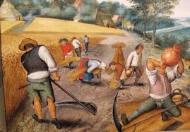
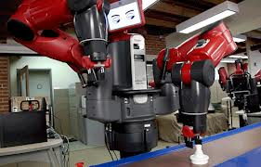
BIOETHICS IN BIOTECHNOLOGY
“Morality is a private and costly luxury.” Henry B. Adams,
Who should control technology?
What should be banned or permitted and who should decide?
Who should profit?
Should access to novel and expensive technology be provided to those who cannot afford it?
Notes:
Many of the questions raised by modern biology and genetic engineering are well worn in other areas. Who should control technology? What should be banned or permitted and who should decide? Who should profit? Should access to novel and expensive technology be provided to those who cannot afford it? If so, who should pay, the government or private individuals. A related issue is that of access to technology for those who live in poor Third World nations. Over the past half century, the gap between the rich and poor has widened. This is partly due to advancing technology. Mechanization has made unskilled human labor less necessary .

Slide 12
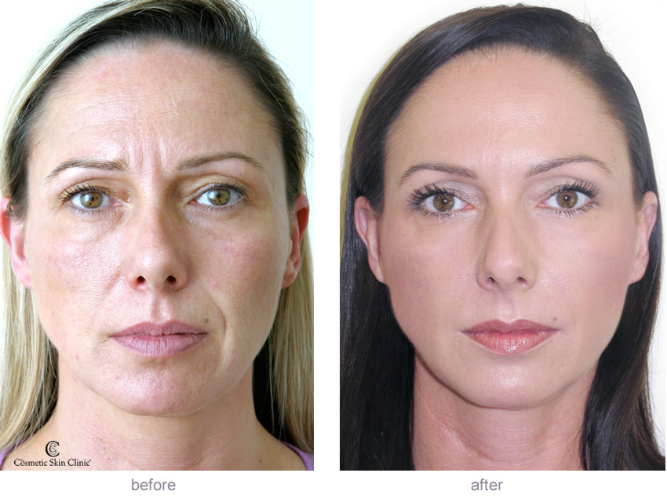
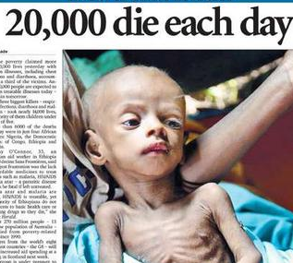
For example, treatment with botulinum toxin (Botox) is now used to remove wrinkles from the skin of the old and ugly. Botox injections cost from $300 to $500 (more than a month’s wages in many Third World nations). More than 1.6 million people received injections in 2011.
The rich have always had greater access to expensive health care, whether drugs, surgery, or simply high-quality nursing.
Notes:
For example, less than 5% of the population is needed to grow food for everyone in the advanced nations (compared to some 90% in medieval times). Automation has also reduced the number of people needed to produce industrial goods. Many clinical procedures involving novel technology are expensive and are beyond the reach of the poor. This is the old question of the distribution of wealth, in a technological guise, and has no special link to genetic engineering. The rich have always had greater access to expensive health care, whether drugs, surgery, or simply high-quality nursing.
For example, treatment with botulinum toxin (Botox) is now used to remove wrinkles from the skin of the old and ugly. Botox injections cost from $300 to $500 (more than a month’s wages in many Third World nations). More than 1.6 million people received injections in 2011. The toxin blocks the release of the neurotransmitter acetylcholine by nerve cells that control muscle contraction; hence its use in very low amounts to inhibit the muscle contraction responsible for wrinkles and frown lines.

Slide 13
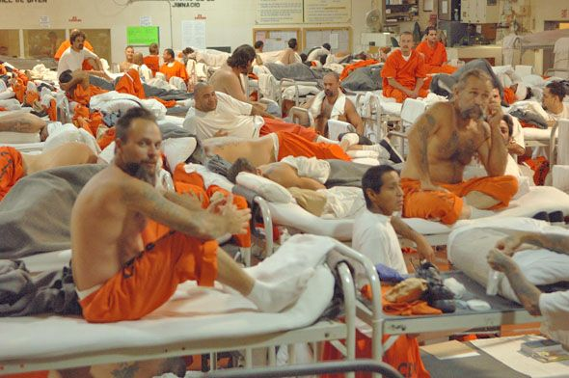
Most inhabitants of Third World nations cannot afford basic antimalarial drugs.
Many do not even have pure drinking water.
Mass immunization against infections with cheaper, more effective vaccines benefits poor people.
Transgenic crops able to grow in poor soils and give higher yields without fertilizers may also help.
But merely saving lives from starvation causes population expansion and overcrowding, thus promoting the spread of infections.

Slide 14
Bioterrorism and germ warfare
The anthrax attacks of 2001–2002 that followed the terrorist destruction of the World Trade Center in United States .
The actual number of casualties was low, yet the associated fear was widespread and became a hot media topic.
Guns and bombs are highly visible.
Infectious microbial agents are invisible to the naked eye. ]

Slide 15
Whether or not research on germ warfare should be done is hotly debated.
Germ warfare has been described as the “poor man’s nuclear weapon.”
Nations too poor to develop costly high-tech weapons could throw together crude biological weapons relatively easily and cheaply.
Germ warfare thus represents a possible means by which Third World nations could protect themselves against the rich nations invader.

Slide 16
Organ Donation
1 donor can save or help as many as 50 people.
Organs you can donate include
Internal organs: Kidneys, heart, liver, pancreas, intestines, lungs
Skin
Bone and bone marrow
Cornea
Most organ and tissue donations occur after the donor has died. But some organs and tissues can be donated while the donor is alive.
People of all ages and background can be organ donors.

Slide 17
Organ replacement, artificial parts, and the Bionic Man
Too few people volunteer to donate their organs resulting in a shortage.
It has been proposed to develop human clones as a source of replacement organs.
Artificial tissues (non-biological) are also being developed.
Another alternative is nanotechnology, the use of engineering on a microscopic scale ( miniature filtration units to replace defective kidneys, or photosensors for defective vision).
Notes:
However, all these options are some what futuristic, and at present, stem cells seem the most likely basis for organ regeneration

Slide 18
Organs are distributed on a first-come-first-served basis combined with urgency.
In Europe - presumed consent laws for organ donation (an individual is willing to contribute organs upon death, unless he or she has registered as a nondonor or there is other evidence to the contrary.

Slide 19
Antibiotics
When bacteria are exposed to antibiotics, they may gain resistance. Overuse and improper use of antibiotics have led to the spread of antibiotic resistance.
It is difficult to find effective antibiotics to treat simple infections.
Certain antibiotics are widely used in agriculture.

Slide 20
Another problem is that antibiotic treatment is often discontinued too early.
If the infecting bacteria are not totally destroyed by completing the course of antibiotic treatment, the survivors may gain resistance and spread.
Poorly educated patients tend to stop taking medication as soon as the symptoms disappear.
The dosage and length of antibiotic treatment are decreased in order to save money.

Slide 21
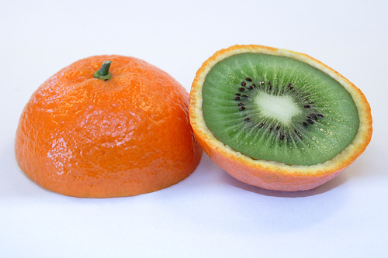
Transgenic Crop plants
There are 3 main issues to consider for transgenic crops.
1 - is whether the food product is safe for human consumption.
2 - is the question of containment.
3 - is the question of hazard to the environment.
In practice, seeds from different batches of corn are impossible to keep wholly separate, and mixing of GMO with natural corn has occurred. DNA of transgenic
origin has been detected in wild plants.
Notes:
Although the term genetically modified organism (GMO) is often used, we should remember that all domesticated plants and animals have been genetically modified by more traditional methods and consequently differ greatly from their wild ancestors

Slide 22
Loss of Biodiversity
Humans have been replacing diverse natural habitats with artificial monoculture for millennia.
Most natural habitats in the advanced nations have already been replaced with some form of artificial environment based on mass production or repetition.
The real threat to biodiversity is surely the need to convert ever more of our planet into production zones to feed the ever-increasing human population.

Slide 23
Our planet’s biodiversity is under threat from human agriculture.

Slide 24
Animal Testing
A generation ago, social activists demanded that medicines, cosmetics, shampoos, foodstuffs, and every other product that might come into contact with a human being should be rigorously tested for safety using animals. This led to massive government legislation mandating such testing. Today’s animal rights activists are demanding less animal testing.

Slide 25
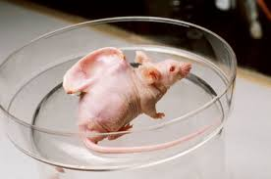
What is Genetic Engineering?
Scientific alterations in human possibilities
Gene Therapy
Stem cell research
Human cloning
Scientific alterations in animal and plant life
Modified grains tolerant of disease and drought
Cloned animals

Slide 26
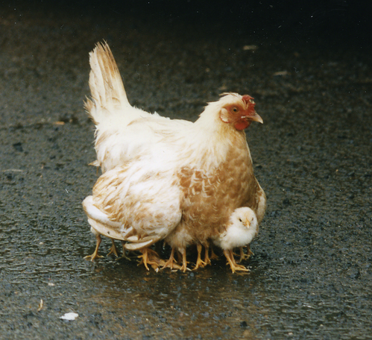
Transgenic Animals and Animal Cloning
Genetic manipulations could create future organisms that are truly bizarre by today’s standards.
By manipulating the homeobox genes, which сontrol body plans and
segmentation, maybe a “chickapede”—a chicken with multiple legs and body segments—
could be created.

Slide 27
Cloning
Cloning is the processes used to create an exact genetic replica of another cell, tissue or organism. The copied material, which has the same genetic makeup as the original, is referred to as a clone. The most famous clone was a Scottish sheep named Dolly.
3 different types of cloning:
Gene cloning, which creates copies of genes or segments of DNA
Reproductive cloning, which creates copies of whole animals
Therapeutic cloning, which creates embryonic stem cells. Researchers hope to use these cells to grow healthy tissue to replace injured or diseased tissues in the human body.

Slide 28
Why clone humans?
Creating replacement tissue (spare parts)
Producing a fully developed human being for infertile couples
Reproducing outstanding humans in history

Slide 29
Moral and Legal Issues of Cloning
Do people have a right to reproduce by any available means?
Do other societal concerns override any such rights?
Will there be harmful effects on the cloned twin?
How will family relationships be redefined?
Could persons be cloned without their consent?
Would cloning be immoral because it is “unnatural”?

Slide 30
Furthermore, environmental and developmental influences would mean that although genetically identical, the clone would not be a true “behavioral replica.” Remember that although identical twins are genetically identical—“natural clones”—they still show considerable divergence in personality, behavior, and ability.

Slide 31
Altering the human germline
Soon it will become possible to deduce such things as the probable future height, eye color, IQ, and beauty of the developing fetus.
Most parents would like to have smart, healthy, and attractive children, and the temptation to have abortions based on these characteristics will soon become a reality.

Slide 32
Genetic Testing
Genetic tests are tests on blood and other tissue to find genetic disorders. About 900 such tests are available.
Reasons:
Finding possible genetic diseases in unborn babies
Finding out if people carry a gene for a disease and might pass it on to their children
Screening embryos for disease
Testing for genetic diseases in adults before they cause symptoms
Confirming a diagnosis in a person who has disease symptoms

Slide 33
Genetic Testing
In some cases, there is no treatment. But test results might help a person make life decisions, such as career choice, family planning or insurance coverage. A genetic counselor can provide information about the pros and cons of testing.

Slide 34
Stem Cells
There are two main types of stem cells: embryonic stem cells and adult stem cells.
Doctors and scientists are excited about stem cells because they have potential in many different areas of health and medical research. Studying stem cells may help explain how serious conditions such as birth defects and cancer come about

Slide 35
Stem Cell Research
Stem cells are the precursors to the differentiated cells that make up the body. Different types of stem cells correspond to different types of tissues. Embryonic stem cells are found in the developing embryo and retain the ability to develop into any body tissue. Embryonic stem cells can be maintained in culture and may be used to create transgenic animals by insertion of DNA.

Slide 36
Stem cell research merges into other areas of biotechnology. If scientists are not allowed to use existing aborted tissue, can they create their own embryos in vitro? How far should such embryos be allowed to develop? Should brain tissue be used, since that is where people believe our consciousness lies?

Slide 37
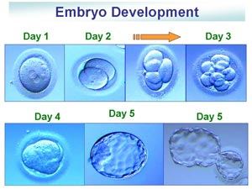
Current IVF embryo policy
Left-over embryos
IVF procedure generates many embryos to increase chances of success
Usually get thrown out or frozen
BUT, stem cells can be derived from these!

Slide 38
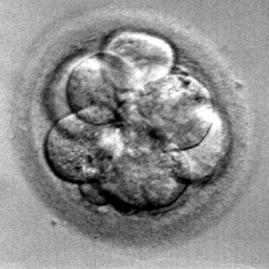
Current IVF embryo policy
What is an IVF clinic?
Place where a couple can go after difficulty conceiving a child
Woman’s eggs extracted; man contributes sperm
Woman’s egg fertilized in-vitro
Outside her body
Embryos inserted into her uterus → pregnancy

Slide 39
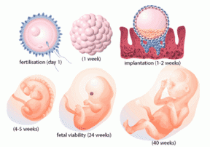
Current IVF embryo policy
Which is ethically “better”?
Throwing out an extra embryo, OR
Saving the embryo for adoption, OR
Using the embryo for biomedical research?
How do we find a compromise?

Slide 40
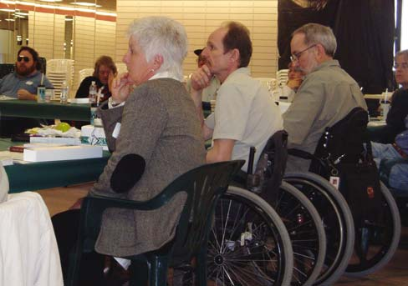
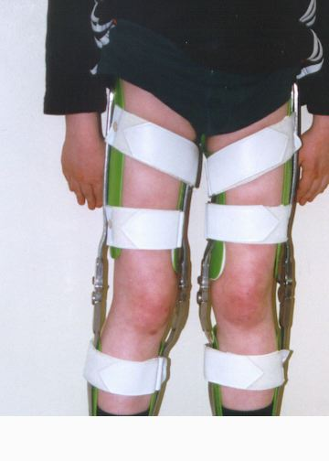
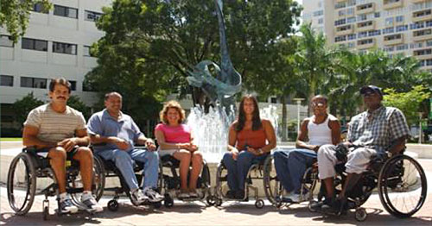
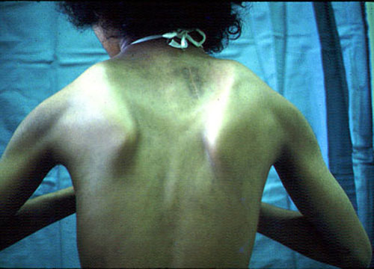
What diseases do we do stem cell research on first?
Muscular dystrophy
likely to die by age 20
VS.
Spinal cord injuries
paralyzed, but likely to live longer

Slide 41
Common concerns in funding decisions
Number of people with the disease.
The groups that suffer from the disease.
Severity of the disease.
Disease mortality.
Average age at death.
Already available therapies or treatments.

Slide 42
Stem cell research merges into other areas of biotechnology. If scientists are not allowed to use existing aborted tissue, can they create their own embryos in vitro? How far should such embryos be allowed to develop? Should brain tissue be used, since that is where people believe our consciousness lies?

Slide 43
Privacy and Personal Genetic Information
It may become possible to predict future health problems by analyzing an individual’s DNA.
Such information might be of interest not only to the individual but also to the health care system, insurance companies, employers, the military, and so on.
Does the health insurance company have a right to know about your potential future health problems?

Slide 44
Conflict of science with traditional religion
Modern advances in biology frequently conflict with traditional morality.
For example, when vaccination first emerged, its use was widely condemned by the Christian church on the grounds that it interfered with God’s will. Epidemics were seen as God’s judgment on sinful man. If God intended you to live, then you would survive the epidemic, and if God wanted you to die, then being vaccinated to avoid this was tantamount to blasphemy.

Slide 45
Health Fraud
You have probably seen ads for miracle cures - a supplement to cure cancer, a diet to cure diabetes. Health fraud involves selling drugs, devices, foods or cosmetics that have not been proven effective. At best, these scams don't work. At worst, they're dangerous. They also waste money, and they might keep your patient from getting the treatment he really needs.

Slide 46
Premature babies
As science gets better and better, extremely premature babies have switched from certain death to possible struggle to survive.
The problem is that such care can be very expensive and doesn’t guarantee health. A baby could survive with retardation and barely functional lungs, for instance, at the cost of several million. By contrast, that same money could have saved hundreds of fully healthy people from starvation.
(Can you imagine having to tell a parent that?)

Slide 47
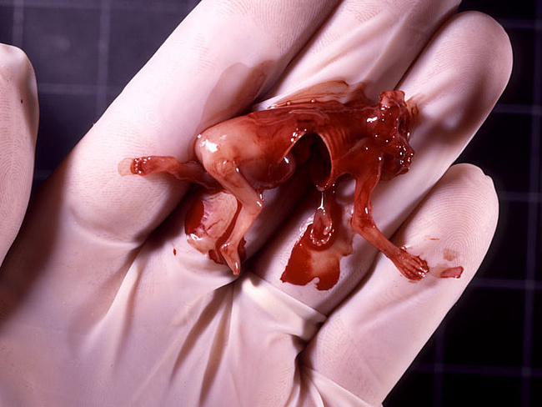
Abortion
Whether or not it is moral, should abortion be legal? Generally prohibited but with some exceptions?
Is it at all times a free choice, or are women responding to coercion in any way?
Is it a free choice to seek abortion in desperation because of poverty, violence, or lack of support?
What should be the community and policy response to women who feel unable to give birth to their children?
And what is the role of the father in decisions about abortion?

