Slide 1
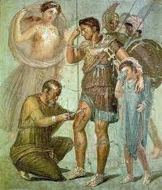
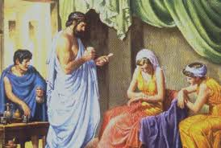
MEDICINE OF ANCIENT GREECE AND ROME.
LECTURER –Pushina O.S.

Slide 2
PLAN.
1. Development of Greek civilization.
2. Alexandria – centre of science and medicine.
3. Rational ideas about diseases – theory of four humors.
4. Irrational ideas about treatment and diseases – asclepions.
5. Hippocrates – Father of Medicine.
6. Ancient Roman civilization.
7. Military medicine of Ancient Rome.
8. Galen – an outstanding anatomist and physician.
Notes:
Y medicine of Ancient Rome.

Slide 3
As the Egyptian civilization faded, the Greek one emerged around 700 BC. The Greek civilization prevailed until "the end of antiquity" around 600 AD.

Slide 4
Instead of growing into a large empire ruled by a monarch, Greece developed as a number of city-states, ruled by a range of governments. Some of were democratic
(Athens), others were under dictatorships
(Macedon), others were ruled by
the military (Sparta).
Notes:
Greek civilization developed in a different way from that of Egypt.

Slide 5
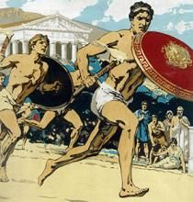
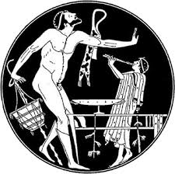
The Greek states built up a wide trading empire. Greek cities became immensely wealthy.
Cultural life - drama, comedy, sculpture, architecture, poetry, politics and public debates.
Phonetic form of writing - more flexible than Egyptian hieroglyphs.

Slide 6
The Greeks developed the use of logic in discussion, and Aristotle used these ideas to advance Greek understanding of mathematics. The teacher Socrates developed a new method of education, which involved asking questions.

Slide 7
Why did things happen?
Greek philosophers found rational reasons for things. Anaximander (6th century BC) suggested that all matter was made up of 'elements' (earth, water, air and fire).
Illness, too, had a natural cause and if a natural cause, therefore a natural cure.

Slide 8
After 300BC Alexander the Great conquered a huge empire, and Greek civilization and ideas spread all over the Middle East.

Slide 9
The city built by Alexander in Egypt, Alexandria, became a centre for study and learning, and was famous for its library.

Slide 10
After philosophers such as Aristotle and Plato decided that the human body was not needed in the afterlife, Greek doctors at Alexandria in Egypt began to dissect bodies. Some even dissected the bodies of criminals who were still alive (vivisection).

Slide 11
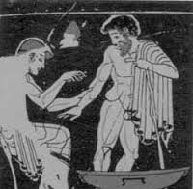
Surgeon Herophilus realised that the brain, not the heart, controls the movement of the limbs.
Erasistratus discovered that the blood moves through the veins (although he did not realise that it circulated).
Thus a systematic way about the inside of the body.

Slide 12
Greeks realised that prayers were useless against illnesses such as the plague, and that epilepsy was not caused by the gods. Hippocrates's book 'Airs, Waters and Places' suggested that disease was caused by the environment. Thus the way was open for an entirely natural theory of the cause of disease.

Slide 13
Idea that the human body consisted of the four humours, which had to be kept in balance. This theory survived until after AD 1700.

Slide 14
This gave Greek doctors their idea Pythagoras came up with the idea of the balance of opposites of the underlying cause of disease.

Slide 15
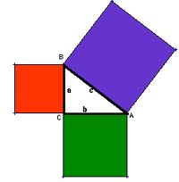
Followers of Pythagoras, Pythagoreans, believed that numbers had precise meanings, especially the numbers 4 and 7.
and that 7x4 is the duration of the lunar month as well as the menstrual cycle (28 days),
7x40 is 280 which is how long a pregnancy is when it reaches full term.

Slide 16
Baby would enjoy better health if he/she was born on the seventh month rather than the 8th.
The 40-day quarantine period to avoid disease contagion comes from the idea that the number forty is sacred.

Slide 17
Hippocrates
The most famous, and probably the most important medical figure in Ancient Greece was Hippocrates, who is known today as "The Father of Medicine".

Slide 18
Hippocrates
Hippocrates collected data and conducted experiments to show that disease was a natural process;
that the signs and symptoms of a disease were caused by the natural reactions of the body to the disease process;
that the chief role of the physician was to aid the natural resistance of the body to overcome the metabolic imbalance and restore health and harmony to the organism.

Slide 19
Four Humors. "The body of man has in itself blood, phlegm, yellow bile, and black bile; these make up the nature of the body, and through these he feels pain or enjoys health. Now, he enjoys the most perfect health when these elements are duly proportioned to one another in respect to compounding, power and bulk, and when they are perfectly mingled. Pain is felt when one of these elements is in defect or excess, or is isolated in the body without being compounded with all the others."

Slide 20
Hippocrates saw pepsis, or an orderly, balanced, harmonious digestion and metabolism of the Four Humors as being essential to all good health. In disorders of pepsis Hippocrates saw the origin of most disease.

Slide 21
Hippocrates' anatomical knowledge was poor, but compensated by knowledge of physiology and the soundness of his reasoning.
His surgical techniques for dislocations of the hip and jaw were unsurpassed until the 19 century.

Slide 22
HIPPOCRATES :
Strengthening and building up the body's inherent resistance to disease.
He prescribed gymnastics, exercise, massage, hydrotherapy and sea bathing.
He prescribed a very slender, light diet during the crisis stage of an acute illness, and a liquid diet during the treatment of fevers and wounds.

Slide 23
A CODE OF CONDUCT
One of the most significant achievements – idea that doctors should follow a set of rules of behaviour. Hippocrates set out a Hippocratic Oath for doctors that outlined the way they should behave.

Slide 24
Greek surgery
Greek doctors became experts at practical first aid.
They also learned about setting broken and dislocated bones
Greek doctors did not have anaesthetics, and only had herbal antiseptics - so successful surgical operations would have been extremely difficult for them to perform.

Slide 25
Greek methods of diagnosis and treatment
The Greek doctors made their medical diagnosis based on examination of their patient from head to foot - this is called clinical observation.
The ancient Greeks came to understand that illness had natural causes, and could not be cured by appealing to their gods. They therefore looked for natural cures, using natural substances such as garlic, vinegar and honey.
Four humours:
They would cure a cold by keeping the patient warm.
They would treat a fever (hot and wet) by keeping the patient cool and dry.
They used bleeding and purging - not, as the Egyptians, to unblock a channel, but in order to rebalance two of the humours - the blood and the black bile.

Slide 26
Irrational treatment
When their doctors could not heal them, many Greeks still appealed to their gods. Asklepios was the Greek god of healing.
The temples built for his worship were used for treating the sick - called an asklepion

Slide 27
Irrational treatment
There they made offering or sacrifice to the god.
Bathe in the sea to cleanse and purify themselves.
After exercising and resting, and perhaps taking certain potions, patients slept the night in the holy place - called the abaton - of the temple.
Here the god and his daughters Hygeia and Panacea came with two holy snakes, and healed the patients.

Slide 28
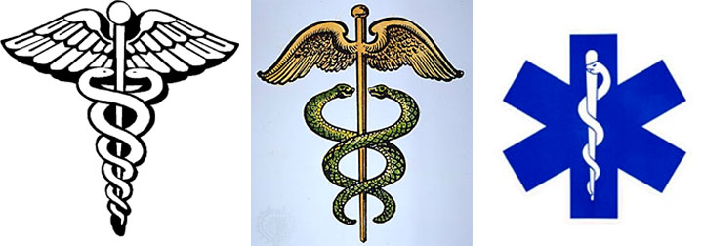
Irrational treatment
The snake is still the symbol of chemists, and words hygiene and panacea have become a part of our language.

Slide 29
MEDICINE OF ANCIENT ROME.

Slide 30
Roman civilization
Ancient Rome was a flourishing civilization that started around 800 BC and existed for approximately 1200 years.
It started off in Rome, and grew into one of the largest and most powerful empires in ancient history.
The empire spread to Southern, Western and parts of Eastern Europe, Asia Minor and North Africa. In many ways, the Roman and Greek empires shared a number values and systems.

Slide 31
Roman civilization
Roman civilization developed into a massive empire, unlike the Greek civilization which consisted of many small city-states.
The Roman empire was centralized; the emperor in Rome was all-powerful and wielded his power, will and laws throughout the empire.

Slide 32
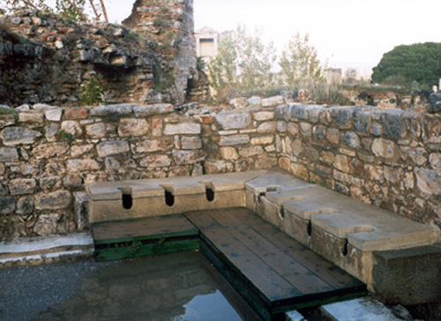
Roman civilization
Roman wealth went more into practical projects and less into culture and philosophy.
The Romans built aqueducts to pipe water to cites, sewers in their capital city, and public baths everywhere.

Slide 33
Medicine in the Early Rome
In the early years there were very few doctors in Rome.
The head of each household was supposed to treat others people.
Specialized medical knowledge was associated with the Greeks.
Greeks were often slaves or ex-slaves and were not well thought of.

Slide 34
The doctors in Ancient Rome did not receive the respect given to doctors today.
In fact, most Romans viewed doctors as cheats and charlatans.
The magical tricks and lack of truly effective treatments led to this reputation.

Slide 35
With the many wars the Roman Empire conducted, military medicine advanced the field.
Military doctors discovered new techniques for treatment and adopted those of the areas they fought against.
Hospitals also developed as a result of military influence (called valetudinaria).
Civilian doctors worked out of the home or in storefronts.

Slide 36
Women played an important role in health care as well in ancient Rome.
Midwives delivered babies and became experts in women's health. They often filled the void left by the ignorance of doctors.

Slide 37
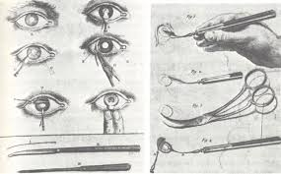
The Romans had several techniques to operate on eyes.
One such operation helped minimize cataracts.
They used a thin needle to push through the eye and break up the cataract.
Then with the small hole in the needle the broken up pieces could be suctioned out.
This procedure restored at least a moderate amount of sight for the patient.

Slide 38
Other operations involved plastic surgery.
Earlobes repaired after years of wearing heavy earrings.
The excess lobe was trimmed and the hole sewn together. Freed slaves prompted another common, but expensive, plastic surgery.
The brandings and scars of the freed slave could be removed for a price.

Slide 39
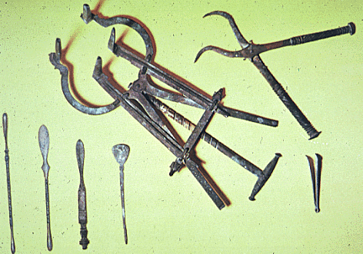
The tools of surgery have given an insight into the methods and advancement of surgery in Rome.
Some of the best discoveries of these tools come from the remains of Pompeii, the city buried in AD 79 under the eruption of Mount Vesuvius. Archaeologists have uncovered the home of a surgeon.
These included scalpels, scissors, and bone forceps, giving clues as to the process of surgery and treatment in Roman society.
Much of what we know of Roman medicine is because of the "House of the Surgeon."

Slide 40
129 AD born in Pergamum( was Greece now Turkey
145AD began to study medicine in his local temple of Asklepios
149AD went to Alexandria to study medicine
159AD surgeon to gladiators in Pergamum

Slide 41
162 AD went to Rome. Physician to the court of Emperor Marco Aurelius
166-7AD returned to work in Pergamum
199 AD died in Rome after 30 years as Rome's leading doctor . By that time he had written over 400 books of which about 100 were known

Slide 42
Galen accepted the idea of the four humours. He based many treatments o this theory but his main importance lay in anatomy and how the body worked.
He was lucky enough to train at Alexandria so he could look at a dissected body.
Dissecting human bodies was forbidden elsewhere due to religion.
He could understand how the brain and nerves worked and showed others by using animals.

Slide 43
The importance of Galen's work
Made a big impact on other civilizations, 1400 years after his death in Rome
He developed the understanding of anatomy
He was one of the first doctors to dissect animals and dead bodies at Alexandria elsewhere it was forbidden
His theories were used for many centuries as they supported many precious Greek theories
His books were handed down for generations and many doctors studied and developed their own ideas from these books.
One of his greatest breakthroughs was that the brain and nerves control the body. He was able to influence many people all over the world. Many couldn’t disagree as his theories were backed up by evidence.
However, Galen only talks about his successful experiments

Slide 44
MODERN AGE | GALEN’S THEORIES
Blood passes from the left side of the heart to the lungs and back to the right side of the heart. | Blood passes through the left side of the heart to the right side of the heart through pores in the heart walls
Blood is made in the spleen | Blood is made in the liver
Blood absorbs oxygen in the lungs | Blood picks up a spirit called pneuma in the lungs
Blood travels around the body giving out oxygen and picking up waste products. | Blood picks up a spirit as it goes around the body
Blood is constantly circulating the body | Blood is used up as it goes around the body

Slide 45
Romans made sure the water they drank and washed from was clean
They realized river water can spread disease. So the Romans built stone covered channels to collect clean water from clean mountains . If they had to cross a valley they built huge bridges called aqueducts that carried water.
Public baths helped people stay healthy as they could wash of flies which caused and spread diseases.
The Roams also built latrines up to 20 people could be seated at once. The toilets were flushed from waste water down into underground sewers which the Romans had built which eventually emptied out into rivers.
The Romans drained many swamps and marshes that were near towns as they realized they caused disease.
Romans did not understand the reason WHY people got ill but they understood hat public health was extremely important.

Slide 47
Thank you for
your
attention!

